Slide 1
Digital Portfolio
STUDENT NAME: SWEETHA T
REGISTER NO AND NMID: 2428B0358 6B03726DE2548D8AC8448E91A7E078E6
DEPARTMENT: BSc.COMPUTER SCIENCE WITH DATA ANALYTICS
COLLEGE: KPR COLLEGE OF ARTS SCIENCE AND RESEARCH

Slide 2
PROJECT TITLE
INSPIRATIONS AND ROLE MODELS

Slide 3
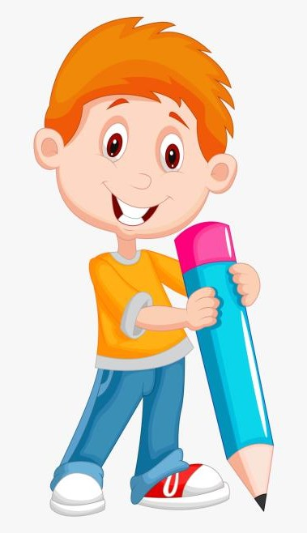

AGENDA
Problem Statement
Project Overview
End Users
Tools and Technologies
Portfolio design and Layout
Features and Functionality
Results and Screenshots
Conclusion
Github Link
3/21/2024 Annual Review

Slide 4

PROBLEM STATEMENT
In today’s fast-paced world, students and young individuals often lack a dedicated digital space to reflect on their inspirations and role models. While social media provides exposure, it is cluttered with distractions and does not offer a focused platform to highlight personal values, motivation, and life lessons from great personalities.
There is a need for a simple, interactive, and visually engaging web application where individuals can showcase their role models, explore inspirational quotes, and personalize their choices. Such a platform can help cultivate positive thinking, encourage self-reflection, and motivate users by celebrating the lives and values of great leaders and personalities.

Slide 5

PROJECT OVERVIEW
The Inspirations & Role Models Web Application is a simple, interactive website developed using HTML, CSS, and JavaScript. It showcases well-known personalities along with their motivational quotes in colourful card layouts, making the interface visually engaging. Users can highlight their chosen role model, which encourages positivity, self-reflection, and value-based learning. The project also serves as a beginner-friendly practice for understanding the basics of web design, responsive layouts, and interactivity. In the future, the application can be enhanced by allowing users to add their own inspirations and personalize the experience further.

Slide 6

WHO ARE THE END USERS?
The end users of the Inspirations & Role Models Web Application are diverse, ranging from students to educators and self-learners. For students and young individuals, the platform provides an opportunity to explore inspiring personalities and their motivational quotes, helping them build confidence, positive thinking, and self-reflection in their daily lives. Teachers and educational institutions can use the project as a supportive learning tool to encourage value-based education, integrate motivational content into classrooms, and foster discussions on leadership, service, and determination. Beyond education, the application is also relevant for general individuals seeking personal growth, who may use it as a quick source of encouragement and moral support. Additionally, beginners in web development form an important category of end users, as the project serves as a simple, hands-on model for understanding the practical use of HTML, CSS, and JavaScript while creating a meaningful and visually engaging application.

Slide 7

TOOLS AND TECHNIQUES
The Inspirations & Role Models Web Application is developed using basic yet powerful front-end technologies. HTML (HyperText Markup Language) is used to structure the content and define elements such as headers, cards, and buttons. CSS (Cascading Style Sheets) is applied to style the webpage, create colourful layouts, and ensure responsive design across different devices. JavaScript is implemented to add interactivity, such as highlighting the selected role model and displaying user alerts. For development, a code editor like Visual Studio Code or Notepad++ is used to write and manage the code efficiently. The project is tested and executed in standard web browsers such as Google Chrome, Microsoft Edge, or Mozilla Firefox to ensure proper functionality. Optionally, online platforms like CodePen or JSFiddle can be used for quick testing, while GitHub Pages can be used for deployment and hosting. These tools and techniques together make the project simple, user-friendly, and beginner-appropriate while demonstrating the essentials of modern web design.

Slide 8
POTFOLIO DESIGN AND LAYOUT
The Inspirations & Role Models Web Application follows a clean, colourful, and user-friendly layout designed to engage users while keeping the interface simple. The header section introduces the theme with a bold title, creating a welcoming start to the webpage. The main content area is structured using a responsive grid layout, where each role model is presented inside a visually distinct card with vibrant gradient backgrounds. Each card contains the name of the personality, a motivational quote, and a button for interaction. The CSS styling ensures smooth hover effects, rounded corners, shadows, and highlight features that make the design attractive and modern. The layout is fully responsive, automatically adjusting the card arrangement across different screen sizes such as desktops, tablets, and mobiles. The use of bright colours, interactive highlights, and consistent typography together creates an aesthetically pleasing design that reflects the motivational theme of the project.
8

Slide 9
FEATURES AND FUNCTIONALITY
The Inspirations & Role Models Web Application provides a simple yet interactive platform that highlights motivational personalities and their quotes. The project includes a colourful card-based design, where each role model is displayed in an attractive layout with gradients, shadows, and hover effects. Users can interact with the webpage by selecting their inspiration through a button, which highlights the chosen card and displays an alert message. The application uses JavaScript functionality to handle interactions such as highlighting and dynamic responses. The design is fully responsive, ensuring that the cards automatically adjust to different screen sizes for accessibility on desktops, tablets, and mobile devices. The combination of HTML for structure, CSS for styling, and JavaScript for interactivity makes the webpage functional, user-friendly, and visually engaging.

Slide 10
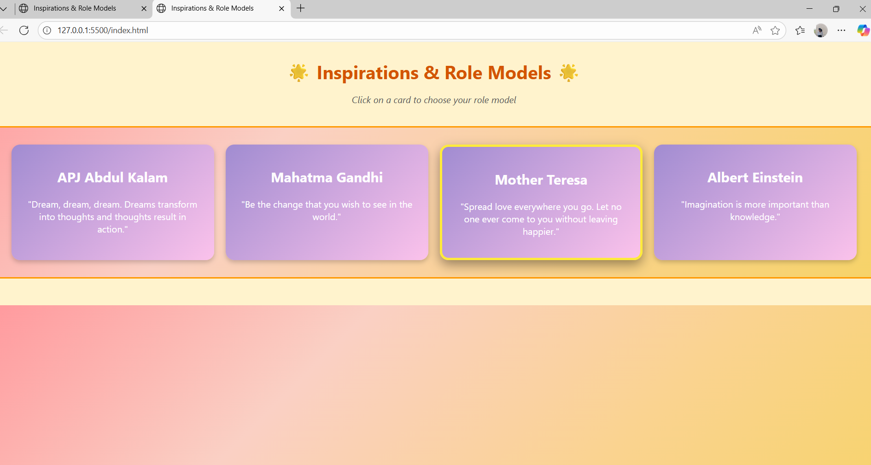

RESULTS AND SCREENSHOTS
3/21/2024 Annual Review
10

Slide 11
CONCLUSION
The Inspirations & Role Models Web Application successfully demonstrates how a simple combination of HTML, CSS, and JavaScript can be used to create an interactive, colourful, and motivational platform. It allows users to engage with inspirational personalities, read their quotes, and select role models that encourage positivity and self-reflection. The project not only provides an easy-to-use and visually appealing experience but also serves as a valuable learning exercise for beginners in web development. By integrating design, responsiveness, and interactivity, the application proves to be both educational and impactful. With future enhancements such as adding custom role models or dynamic content, the project has the potential to evolve into a more personalized and widely usable motivational platform.
11

Slide 12
GITHUB LINK
https://swee2006.github.io/Sweetha17/

